Slide 1
Randomized Algorithms CS648
Lecture 21
Leader election in distributed environment
Probabilistic Method (part 1)

Slide 2
Part I
Randomized Algorithm for Distributed Leader Election

Slide 3










$$T$$
$$T$$
$$H$$
$$T$$
$$H$$
$$T$$
$$H$$
$$T$$
$$T$$
$$T$$

Slide 4















$$T$$
$$T$$
$$18832908$$
$$H$$
$$T$$
. . . .
$$H$$
$$89013782$$
$$T$$
$$T$$
$$H$$
$$38127428$$
$$T$$
$$T$$

Slide 5
. . . .

Slide 6

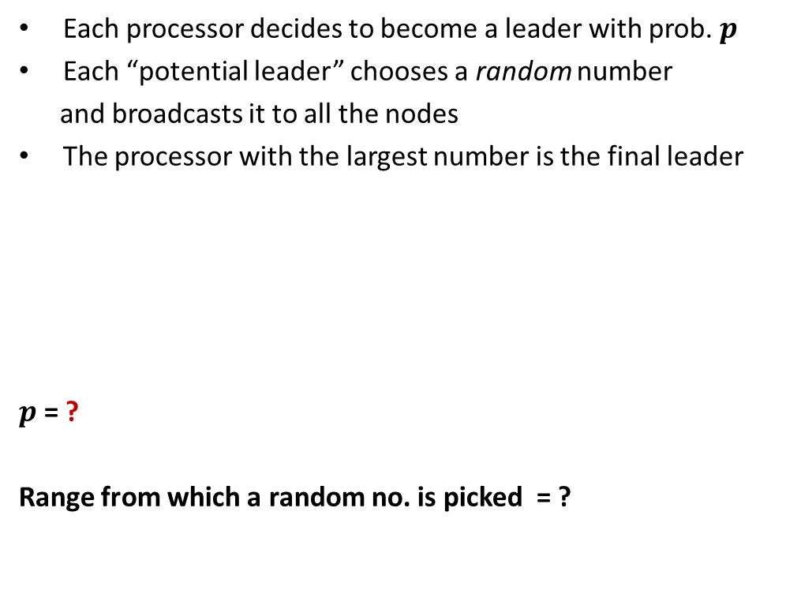

Each processor decides to become a leader with prob. $p$
Each “potential leader” chooses a random number
and broadcasts it to all the nodes
The processor with the largest number is the final leader
$p$ = ?
Range from which a random no. is picked = ?
To Ensure that there is at least one potential leader with high probability.
$$\frac{3\left(log n\right)}{n}$$
To ensure that no two potential leaders pick the same random number with high probability.
$$[1,n^{4}]$$

Slide 7
$$T$$
$$T$$
$$H$$
$$T$$
$$H$$
$$T$$
$$H$$
$$T$$
$$T$$
$$T$$

Slide 8
$$T$$
$$T$$
$$18832908$$
$$H$$
$$T$$
$$H$$
$$89013782$$
$$T$$
$$T$$
$$H$$
$$38127428$$
$$T$$
$$T$$

Slide 9




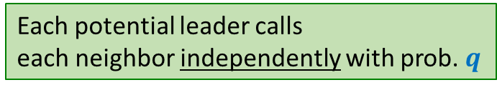
Each potential leader calls
each neighbor independently with prob. $q$
Probability of no common neighbor =
$${\left(1−q^{2}\right)}^{n}$$
$$≈1/n^{4}$$
$$2\sqrt{\frac{log n}{n}}$$
$$q= ?$$

Slide 10
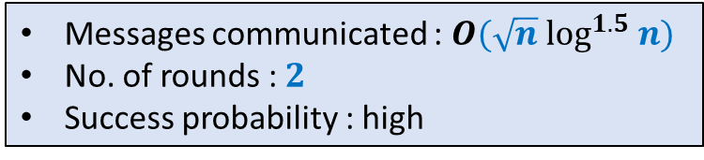
Each potential leader calls
each neighbor independently with prob. $q$
Homework: Work on all the details
Messages communicated : $O(\sqrt{n} \log^{1.5} n)$
No. of rounds : $2$
Success probability : high

Slide 11
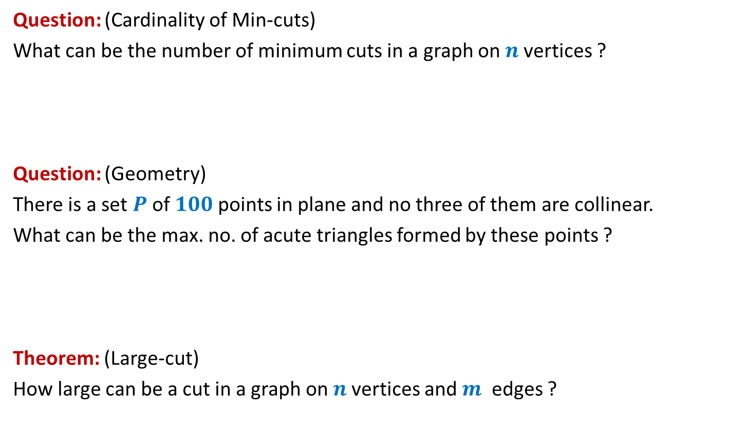
Questions from Discrete Mathematics
Question: (Cardinality of Min-cuts)
What can be the number of minimum cuts in a graph on $n$vertices ?
Question: (Geometry)
There is a set $P$of $100$points in plane and no three of them are collinear.
What can be the max. no. of acute triangles formed by these points ?
Theorem: (Large-cut)
How large can be a cut in a graph on $n$vertices and $m$ edges ?

Slide 12
Probabilistic methods

Slide 13
Probabilistic methods
Methods that use
Probability theory or
Randomized algorithm
to prove deterministic combinatorial results

Slide 14
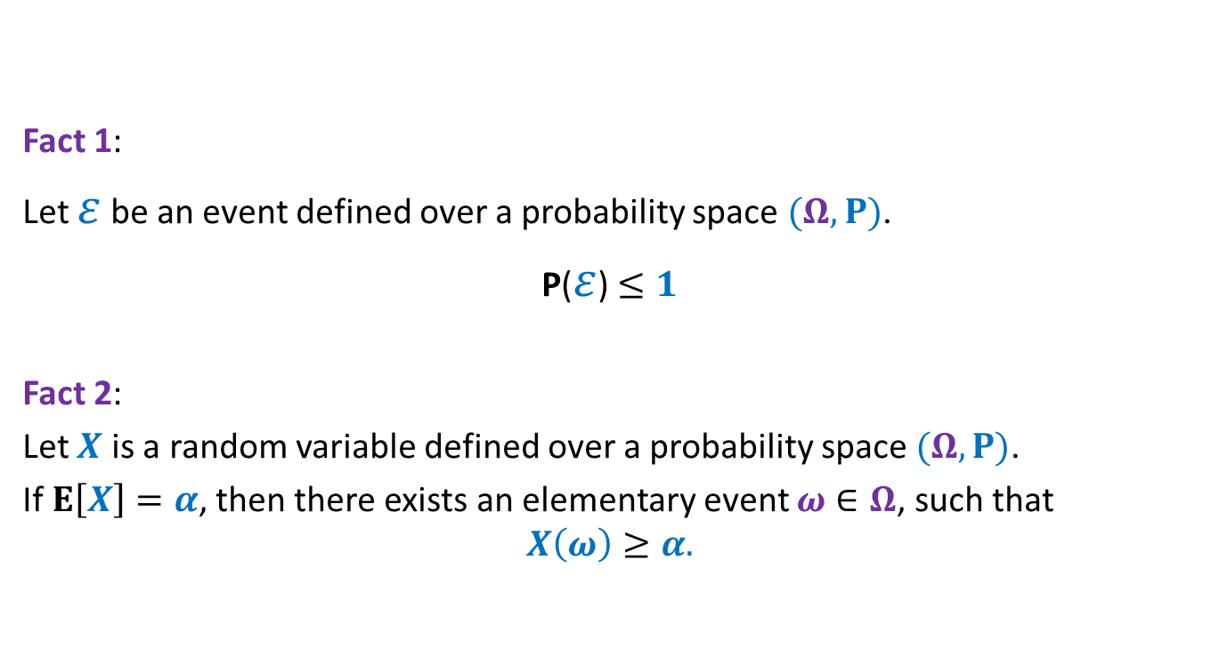
Elementary facts from probability theory
Fact 1:
Let $ε$ be an event defined over a probability space $(Ω,P)$.
P($ε$)$≤1$
Fact 2:
Let $X$ is a random variable defined over a probability space $(Ω,P)$.
If $E\left[X\right]=α$, then there exists an elementary event $ω∈Ω$, such that
$$X\left(ω\right)≥α.$$

Slide 15
problem 1 How Many min CUTs ?

Slide 16


Min-Cut
$G=(V,E)$: undirected connected graph
Definition (cut):
A subset $C⊆E$whose removal disconnects the graph.
Definition (min-cut): A cut of smallest size.
Question: How many cuts can there be in a graph?
$$\frac{2^{n}−2}{2}$$
Question: How many min-cuts can there be in a graph?

Slide 17



Question: How many min-cuts can there be in a graph?
$$n−1$$
$$\frac{n\left(n−1\right)}{2}$$
$n$ nodes
Notes:
Cycle (not a circular graph)

Slide 18
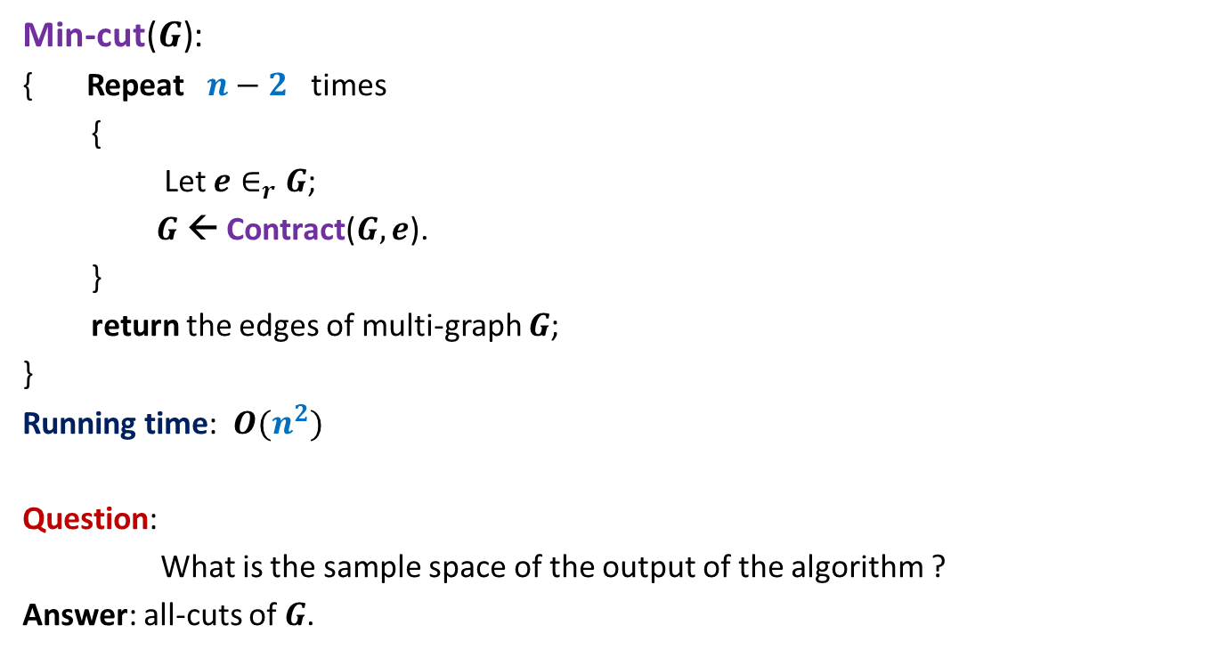
Algorithm for min-cut
Question: How many min-cuts can there be in a graph?
Min-cut($G$):
{ Repeat $n−2$ times
{
Let $e∈_{r}G$;
$G$ ← Contract($G,e$).
}
return the edges of multi-graph $G$;
}
Running time: $O(n^{2})$
Question:
What is the sample space of the output of the algorithm ?
Answer: all-cuts of $G$.

Slide 19
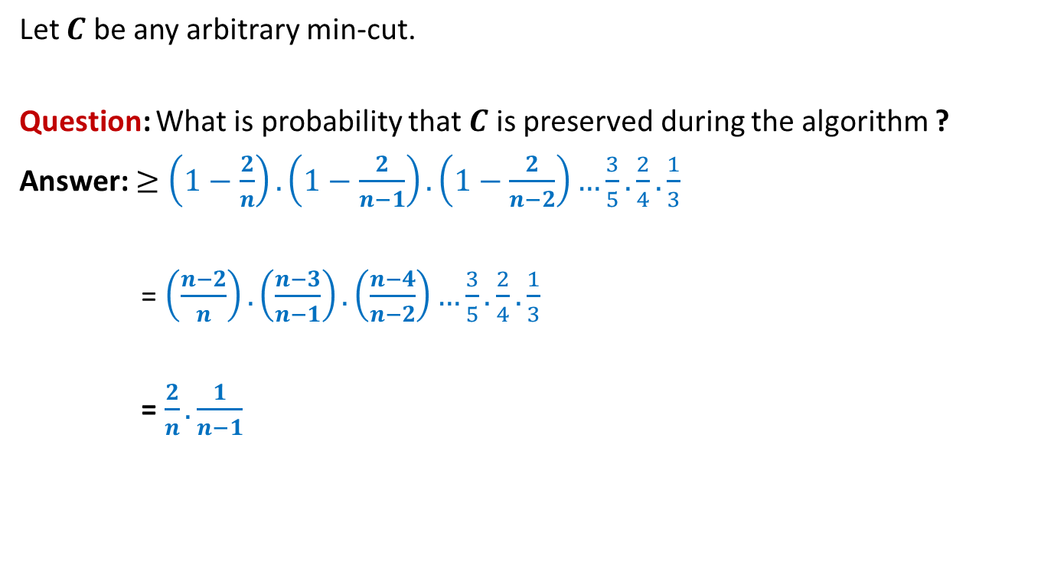
Analysis of Algorithm for min-cut
Let $C$ be any arbitrary min-cut.
Question: What is probability that $C$ is preserved during the algorithm ?
Answer: $≥\left(1−\frac{2}{n}\right).\left(1−\frac{2}{n−1}\right).\left(1−\frac{2}{n−2}\right)…\frac{3}{5}.\frac{2}{4}.\frac{1}{3}$
= $\left(\frac{n−2}{n}\right).\left(\frac{n−3}{n−1}\right).\left(\frac{n−4}{n−2}\right)…\frac{3}{5}.\frac{2}{4}.\frac{1}{3}$
= $\frac{2}{n}.\frac{1}{n−1}$

Slide 20








Number of min-cuts
$ℰ$: outputs of the algorithm Min-cut($G$) is correct.
Let there be $k$ min-cuts in $G$.
Let these min-cuts be $C_{1},C_{2},…,C_{k}$.
Define event $ℰ_{i}$ : “output of the algorithm Min-cut($G$) is $C_{i}$”.
P($ℰ_{i}$)$≥ ?$
P($∪_{i}ℰ_{i}$) $? \text{P}\text{(}ℰ_{1}\text{)}\text{+}\text{P}\text{(}ℰ_{2}\text{)}\text{+...}\text{P}\text{(}ℰ_{k}\text{)}$
$≥ k\frac{2}{n(n−1)}$
➔$1≥k\frac{2}{n(n−1)}$
➔$k≤ \frac{n(n−1)}{2}$
P($ℰ$) $≤1$
$$\frac{2}{n(n−1)}$$
$$ℰ$$
$$= ∪_{i}$$
$$ℰ_{i}$$
$$?$$
$$=$$
At the end of the algorithm
Disjoint events
…
we are left with a multigraph with 2 vertices. Each of these vertices corresponds to a unique subset of vertices. So the corresponding cut is uniquely defined.

Slide 21
problem 2 How many Acute Triangles ?

Slide 22
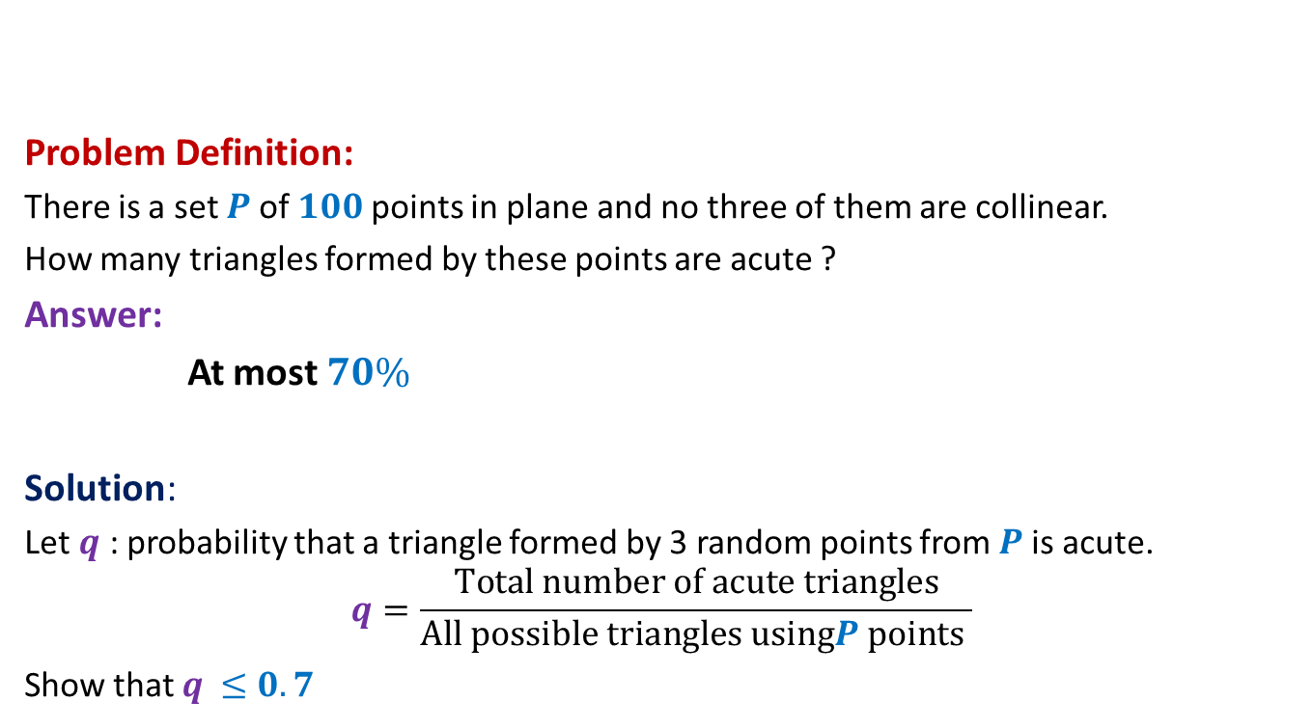
How many acute triangles
Problem Definition:
There is a set $P$of $100$points in plane and no three of them are collinear.
How many triangles formed by these points are acute ?
Answer:
At most $70\%$
Solution:
Let $q$ : probability that a triangle formed by 3 random points from $P$is acute.
$$q=\frac{Total number of acute triangles}{All possible triangles usingP points }$$
Show that $q$ $≤0.7$

Slide 23
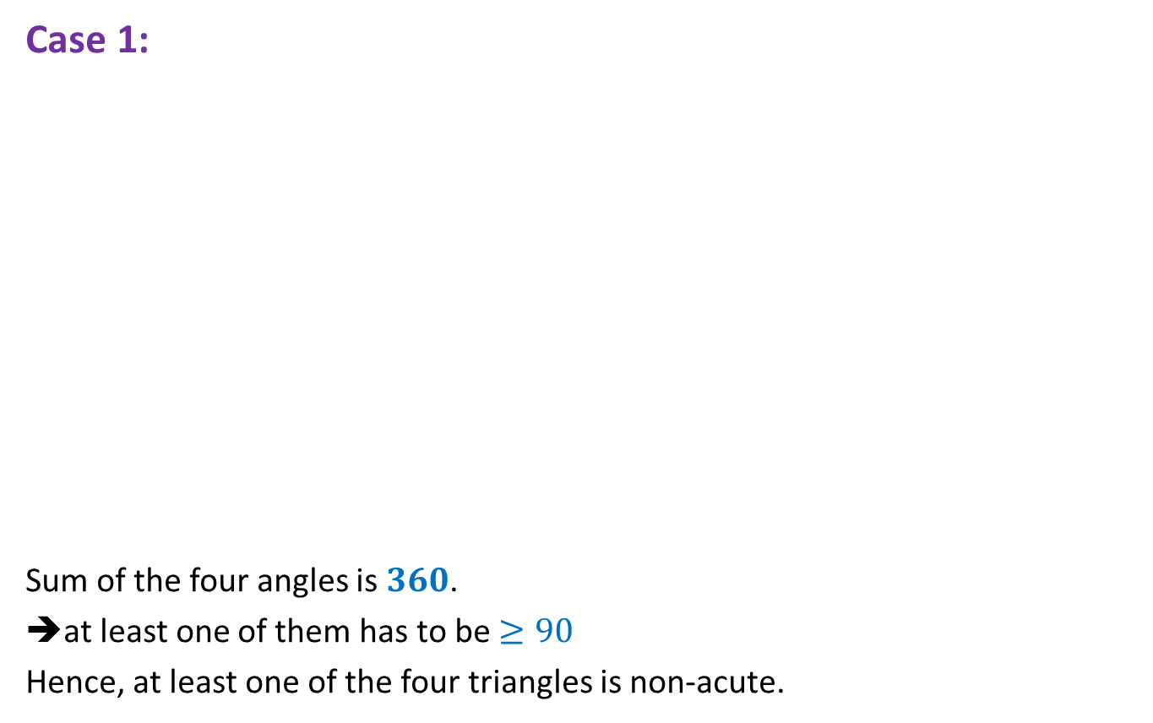

$4$ points
Case 1:
Sum of the four angles is $360$.
➔at least one of them has to be $≥90$
Hence, at least one of the four triangles is non-acute.

Slide 24
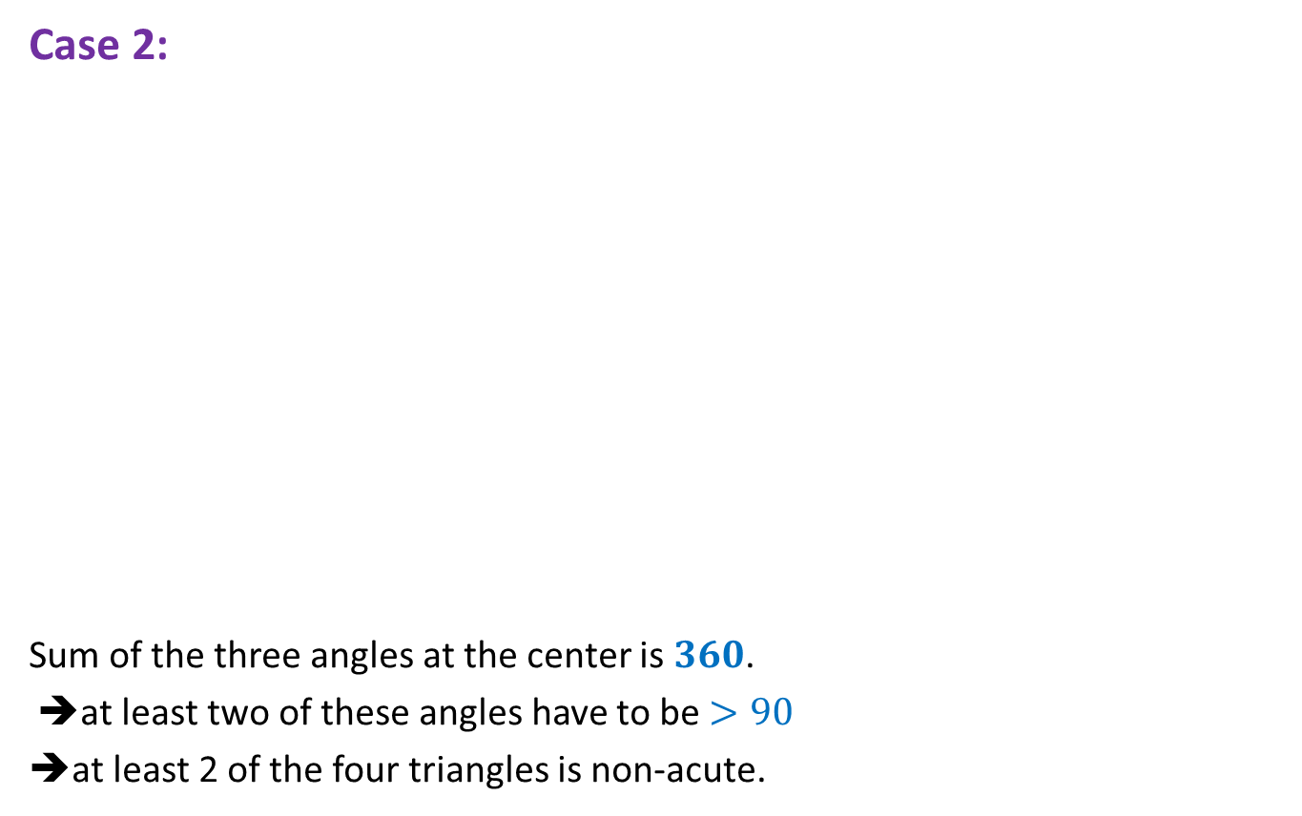
$4$ points
Case 2:
Sum of the three angles at the center is $360$.
➔at least two of these angles have to be $>90$
➔at least 2 of the four triangles is non-acute.

Slide 25


$4$ points ➔ $5$ points
Lemma1: A triangle formed by selecting 3 points randomly uniformly
from 4 points is acute triangle with probability at most $0.75$.
Lemma2: A triangle formed by selecting 3 points randomly uniformly
from 5 points is acute triangle with probability at most $0.7$.
Extension to 100 points ?
☹

Slide 26

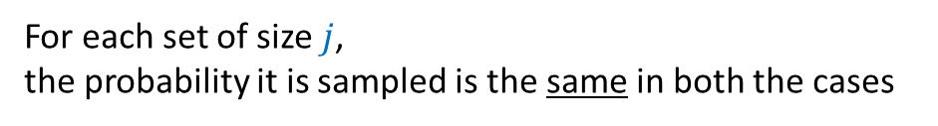



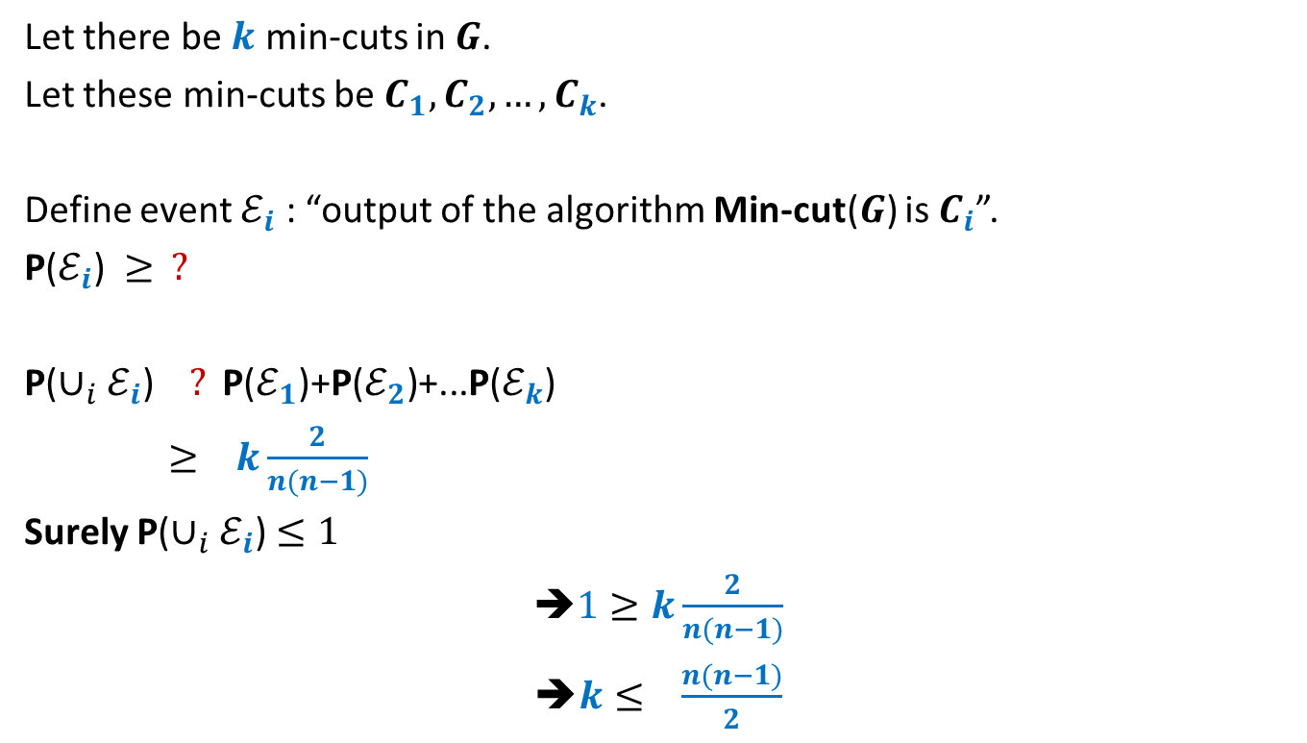






Two stage sampling
How to show this formally ?
$$j≤k≤n$$
$$R_{2}$$
$$j$$
?
Same probability distribution
$$R_{1}$$
$$k$$
$$R$$
$$j$$
$$S$$
$$n$$
$$S$$
$$n$$
Show that:
For each set of size $j$,
the probability it is sampled is the same in both the cases

Slide 27




Two stage sampling
$$j≤k≤n$$
$$R_{2}$$
$$j$$
$$3$$
?
Same probability distribution
$$5$$
$$R_{1}$$
$$k$$
$$3$$
$$R$$
$$j$$
$$S$$
$$n$$
$$S$$
$$n$$

Slide 28




Number of acute triangles
$S$: set of $n$ points.
$q$ : probability that a triangle formed by 3 random points from $S$is acute.
$q$ = ?
$R_{1}$ : a uniformly random sample of $5$points from $S$.
$q$ = ?
➔ $q≤0.70$
P(a random triangle from $S$ is acute)
= P(a random triangle from $R_{1}$ is acute)
$$≤0.70$$

Slide 29
problem 3 Large CUT in a graph

Slide 30
Undirected graph

Slide 31
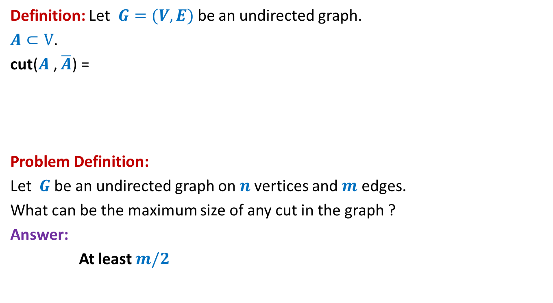
Large cut in a graph
Definition: Let $G=(V,E)$be an undirected graph.
$A⊂V$.
cut($A$, $\overline{A}$) =
Problem Definition:
Let $G$be an undirected graph on $n$vertices and $m$ edges.
What can be the maximum size of any cut in the graph ?
Answer:
At least $m/2$
{ $\left(u,v\right)∈E$) : $u∈A$, $v∈$ $\overline{A}$ or $u∈\overline{A}$, $v∈$ $A$}

Slide 32


Large cut in a graph
$$A$$
$$\overline{A}$$

Slide 33
Large cut in a graph
$$A$$
$$\overline{A}$$

Slide 34

Large cut in a graph
A randomized algorithm:
$A$←∅;
Add each vertex from $V$to $A$randomly independently with probability $\frac{1}{2}$.
Return the cut defined by $A$.

Slide 35

Large cut in a graph
$X$: size of cut ($A,\overline{A}$) returned by the randomized algorithm.
E[$X$] = ??
$$X_{e}:\left\{\begin{aligned}1 if e is present in the cut \\ 0 otherwise \end{aligned}\right.$$
$X=\sum_{e}{X_{e}}$
E[$X$] $=\sum_{e}{{E[X}_{e}]}$
$=\sum_{e}{{P(X}_{e}=1)}$

Slide 36









Large cut in a graph
$$A$$
$$\overline{A}$$
$$u$$
$$v$$
$$u$$
$$v$$
$$v$$
$$u$$
$$e$$
$$\frac{1}{4}$$
+
$$\frac{1}{4}$$

Slide 37

Large cut in a graph
$X$: size of cut ($A,\overline{A}$) returned by the randomized algorithm.
E[$X$] = ??
$$X_{e}:\left\{\begin{aligned}1 if e is present in the cut \\ 0 otherwise \end{aligned}\right.$$
$X=\sum_{e}{X_{e}}$
E[$X$] $=\sum_{e}{{E[X}_{e}]}$
$=\sum_{e}{{P(X}_{e}=1)}$
$=\sum_{e}{\frac{1}{2}}$
$=\frac{m}{2}$

Slide 38

Large cut in a graph
Using Fact 2,
there is a cut of size at least $\frac{m}{2}$ in every graph with $m$edges.

